Slide 1

Data Analysis of IPL(2008-2019)
By:- Team Eight Gentelmen’s

Slide 2
agenda of project
As we know cricket is the game of uncertainity,where a single over can change the momentum of the game.
So, in this project we analyze the past matches data and by analyzing them we extract the essential and meaningful insights.
The insights from the dataset can help the team to improve themselves,it can help management and coach to decide a best playing 11 from the team.
The insights also helps the advertisement companies to reach the relevant audience across the nation,it can influence the market performance.
So main aim of the project is:-
• Created a model that predicts the score (in terms of range) of IPL matches
• To help advertisement companies to advertise their product to the maximum and relevant audience. • Optimized Multiple-Linear, Decision Tree, Random Forest, Ridge Regression, Lasso Regression.

Slide 3

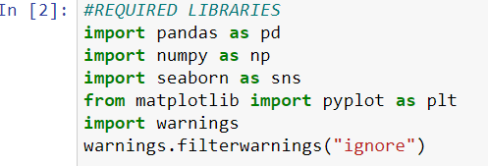
Tools and libraries used for analysis of dataset
The tool used for the analysis of the dataset is jupyter notebook and python.
PYTHON LIBRARIES USED
1. Pandas
2. Numpy
3. Seaborn
4. Matplotlib
5. Pickel

Slide 4
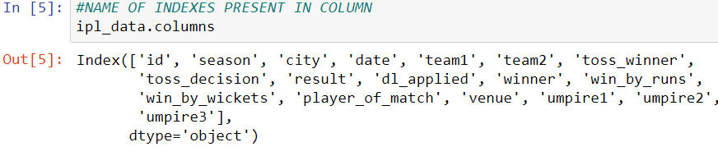

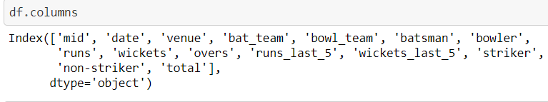

Details of dataset
For this project we took two datasets from the kaggle.
1.Matches.csv which contains the data of IPL matches from 2008-2017.The dataset has nearly 636 rows and 18 columns.
2.Ipl.csv which contains the data of IPL matches from 2008-2019 with detailed ball-to-ball details of every match.The dataset has 76014 rows and 15 columns.

Slide 5
Data cleaning
We perform data cleaning technique in both the dataset that we took from kaggle i.e matches.csv & ipl.csv.
Action performed in this section are:-
1. Removing of unwanted columns.
2. Keeping only consistent teams which played almost all seasons.

Slide 6


3. Removing the first 5 over data from every match.
4. Converting the column name ‘date’ from string into datetime object.

Slide 7
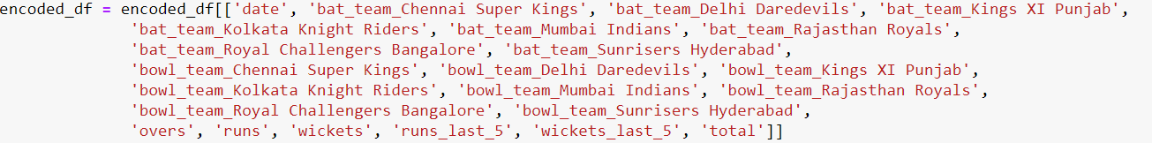
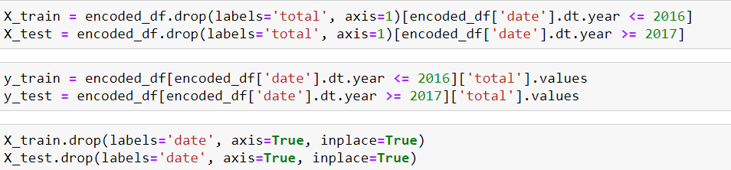
Data preprocessing
Action performed in this section are:-
1. Handling categorical features using OneHotEncoding method.
2. Rearranging the columns.
3. Splitting the data into train and test set.

Slide 8
DATA visualization & eda
In this project we use some data visualization tools to visualize our datasets.
Some of them are:-
1. Bar-graph
2. Pie-chart
3. Histogram
4. Heatmap
5. Tableau.
In upcoming slides there are some visualized data with lots of information that can help teams, players, coach & management to took better decisions.
With the help of Bivariate analysis we perform Exploratory data analysis of IPL dataset.

Slide 9
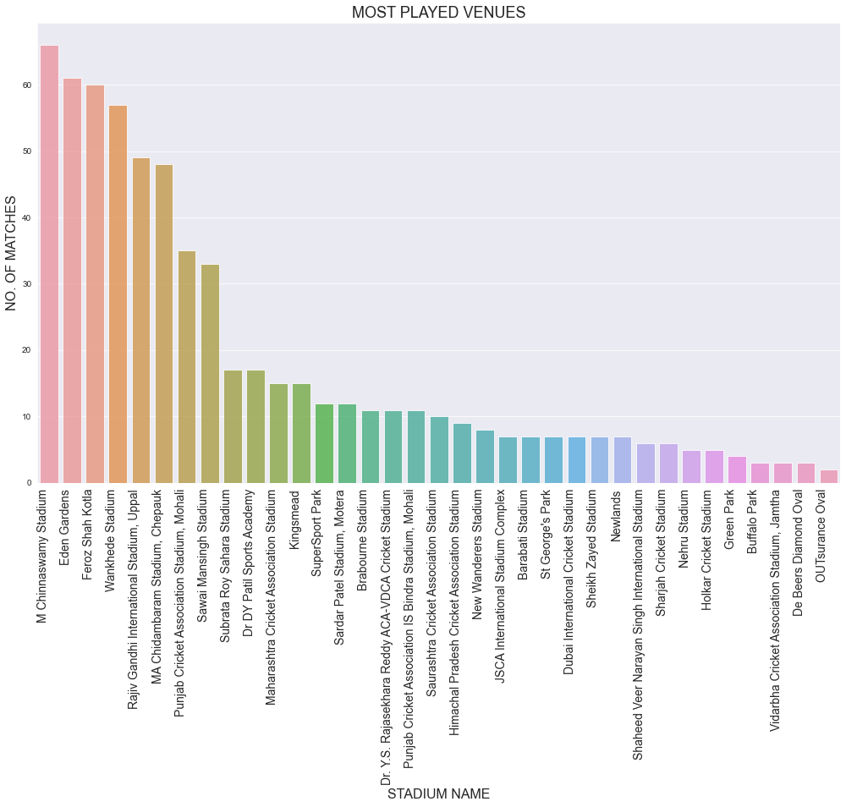
MOST STADIUM HOSTED MAXIMUM NUMBER OF MATCHES?
.
Conclusion:-M chinnaswamy stadium hosted most number of matches with total 66 matches.

Slide 10
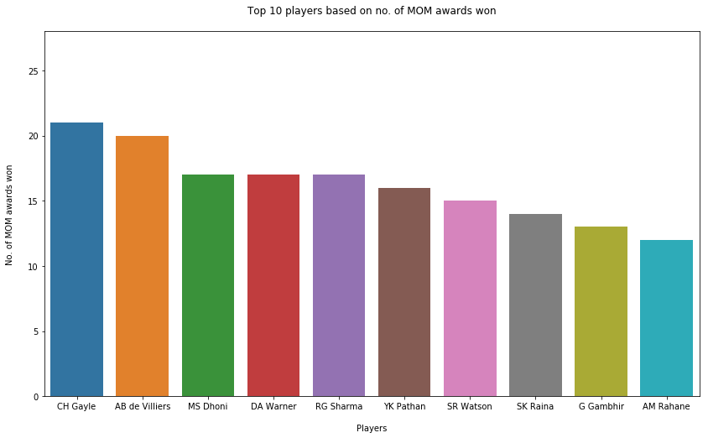
BATSMAN WITH MAXIMUM NUMBER OF MAN OF THE MATCH TITLE?
Conclusion:-Chris Gayle is the most successful batsman in the history of ipl and he also won most number of man of the match title with total 21 titles.

Slide 11
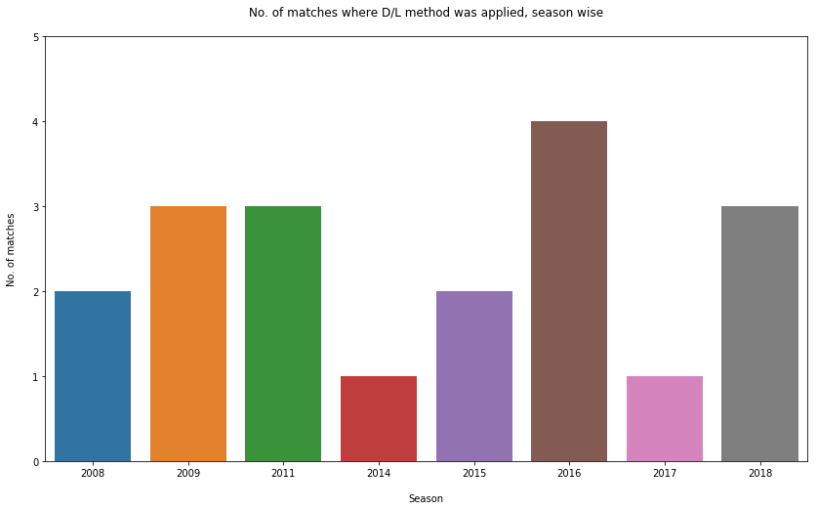
NUMBER OF MATCHES IN WHICH DUCKWORTH-LEWIS-STERN METHOD WAS APPLIED?

Slide 12
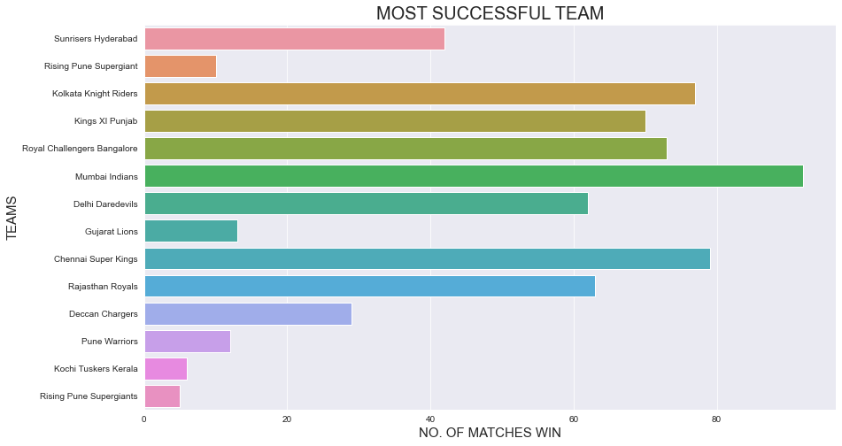
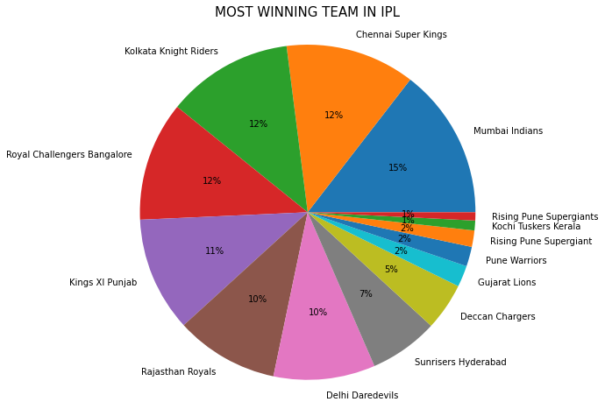
MOST SUCCESSFUL TEAM IN THE HISTORY OF IPL?
Conclusion:-Mumbai Indians won most number of matches in IPL and hence it is most successful team of IPL.

Slide 13
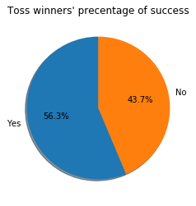
WHAT IS THE EFFECT OF TOSS ON THE MATCH RESULT?
Conclusion:-The above graph shows that the match can go either way where toss winner have very slight edge.Graph concludes the unpredictability of a match.

Slide 14
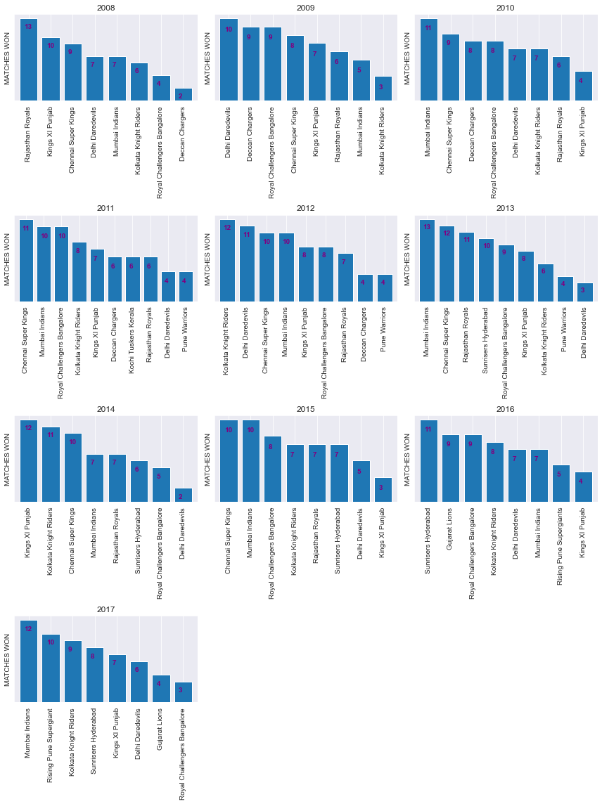
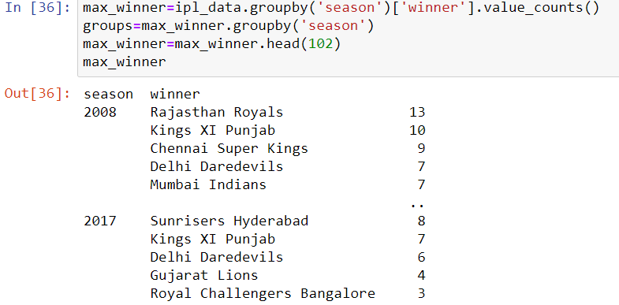
MOST NUMBER OF MATCHES WIN BY TEAMS IN EACH SEASON OF IPL?

Slide 15
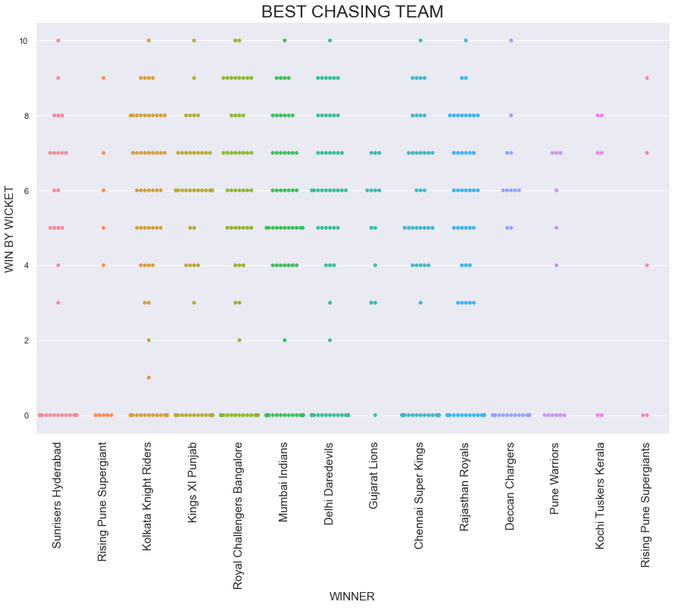
WHICH TEAM IS BEST CHASSING TEAM IN IPL?
Conclusion:-Royal Challenger Bangloure is best chasing team in IPL.

Slide 16
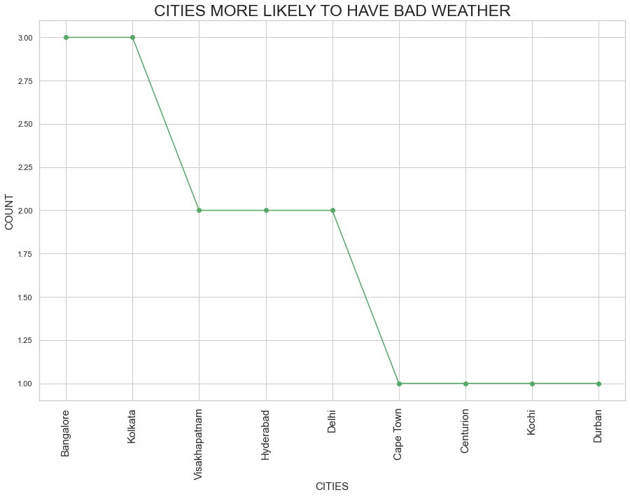
WHICH CITIES ARE MOST LIKELY TO HAVE BAD WEATHER?
Conclusion:-Bangalore and Kolkata are cities more likely to have a bad weather,hence it is not a good option to host knockout matches there.

Slide 17
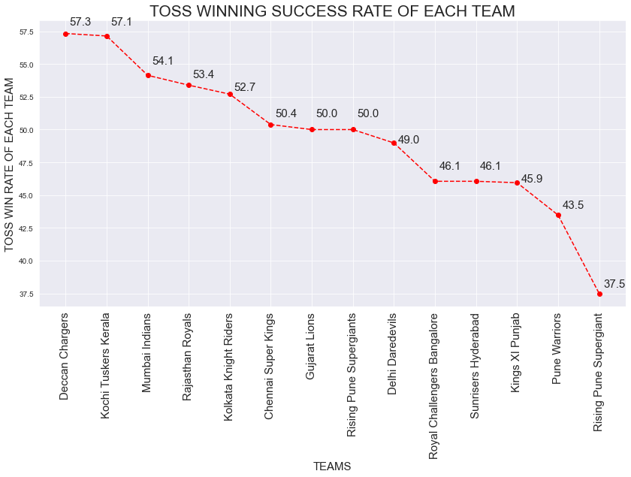
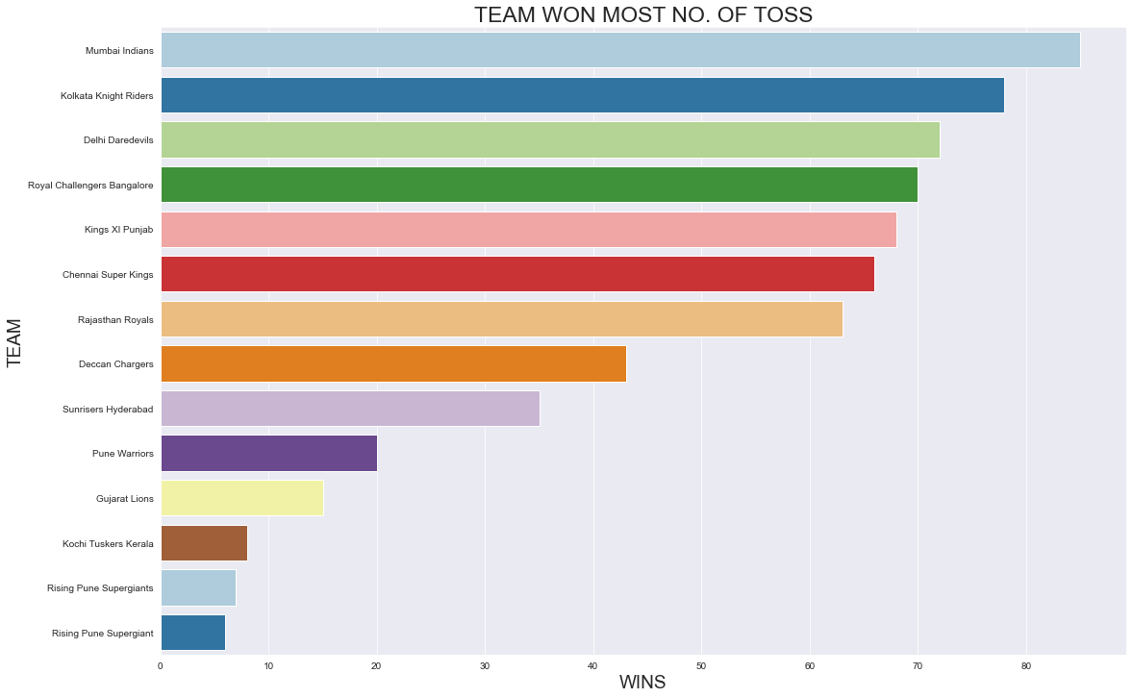
WHICH TEAM HAS BEST TOSS WINNING SUCCESS RATE?
Conclusion:-There are high chances of team like Deccan,Kochi & Mumbai to win a toss.

Slide 18
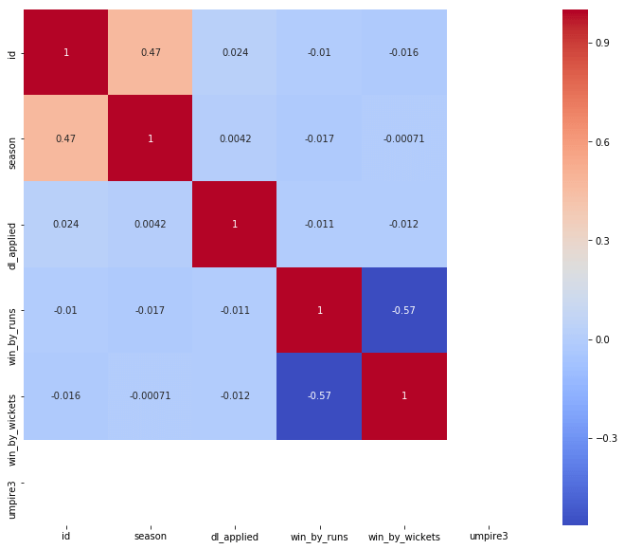
SHOW THE COORELATION BETWEEN WIN BY WICKETS AND WIN BY RUNS.
Conclusion:-There is a negative correlation between the win by runs and win by wickets as one variable increases and another variable decrease or vice versa.

Slide 19
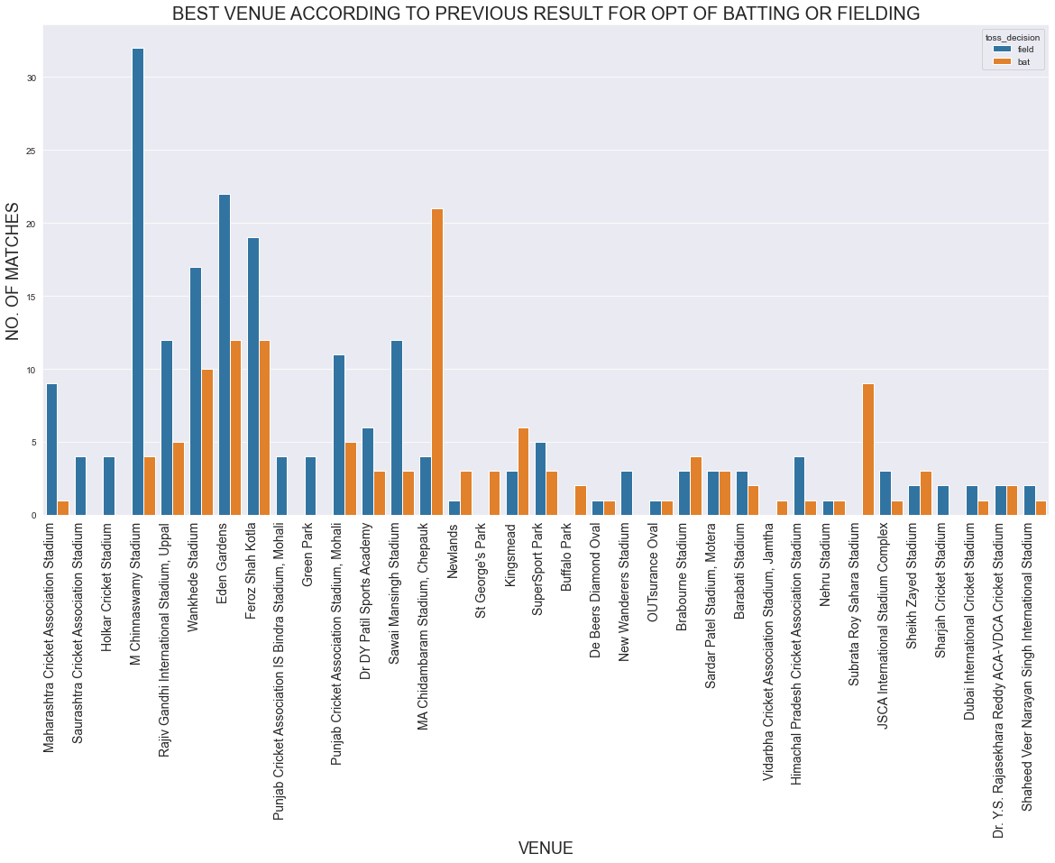
WHICH STADIUM IS BEST FOR TO DO BATTING IN THE FIRST INNINGS OF THE MATCH?
Conclusion:-M Chinnaswamy stadium is best for field first after winning toss & Eden Garden stadium is best for bat first after winning toss.

Slide 20
IN WHICH MATCHES THE ADVERTISEMENT COMPANIES SHOULD ADVERTISE THEIR PRODUCTS MORE SO THAT THEIR PRODUCT REACHES TO MAXIMUM AUDIENCE, AND HENCE THEY GOT MORE PROFIT?
The answer of this question is directly depend on the result of most viewed matches by audience by means of television or other ott platforms.
With 11.2 billion minutes, the MI-CSK game became the most-watched IPL mid-season match ever (in BARC history). This match also became the most-watched match of season 14. This is in addition to IPL 2021 surpassing the overall reach to 367 million versus 357 million in 2020.
Moreover, the Mumbai Indians team 2021 found the spot 3 times in the 5 most-watched programs list. Match 17 that took place between the Mumbai Indians and the Punjab Kings was on the 2nd most top of the list with 22,047 people watching the match live per minute. The match took place on Friday, 23 April at the MA Chidambaram Stadium in Chennai.
The 3rd spot on the list for the most watched programs was taken by Match 15 between the Chennai Super Kings and the Kolkata Knight Riders. The 4th spot went to Match 16 between the Rajasthan Royals and the Royal Challengers Bangalore. The subsequent 4th and 5th positions went to matches involving the Mumbai Indians team 2021, which made them appear 3 times on the list.
So,by analyzing the most viewed matches data which would be taken from BARC & hotstar we conclude that it would be beneficial for advertising companies to advertise their product more in especially during the day when Mumbai Indians would play matches.

Slide 21


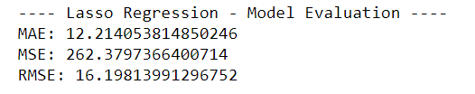


OPTIMISATION OF LINEAR REGRESSION, RIDGE REGRESSION, LASSO REGRESSION, DECISION TREE AND RANDOM FOREST MODELS.
Machine Learning Models Used:-
1. Linear Regression
2. Ridge Regression
3. Lasso Regression
4. Decision Tree
5. Random Forest

Slide 22
MODEL BUILDING AND MODEL PREDICTION
Evaluation metrics are used to measure the quality of the statistical or machine learning model, the evaluation metrics here we consider is RMSE (Root Mean Squared Error).
And by optimising different models we have the RMSE value of each model which were as follows:-
1.Linear Regression RMSE:- 15.8432
2.Ridge Regression RMSE:- 15.8439
3.Lasso Regression RMSE:- 16.1981
4.Decision Tress Regression RMSE:- 23.0446
5.Random Forest Regression RMSE:- 18.1717
Since Linear Regression model performs best as compared to the other four models so we this model for prediction.

Slide 23
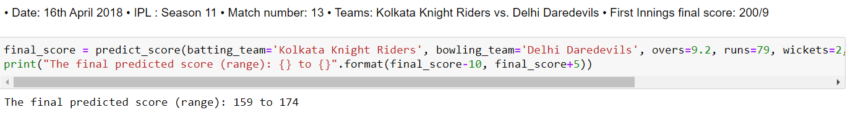
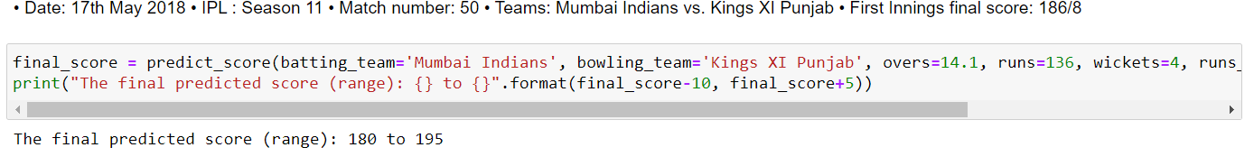
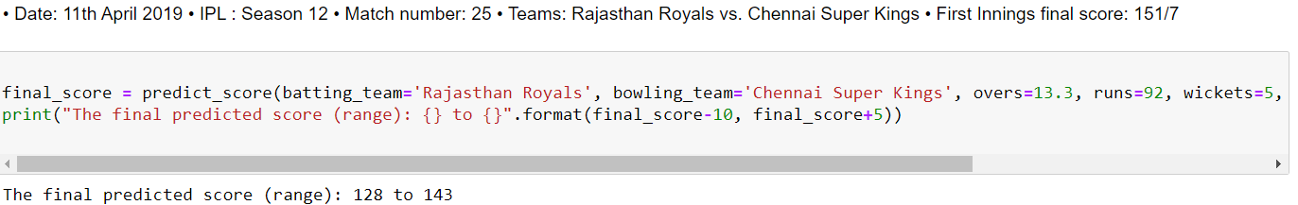
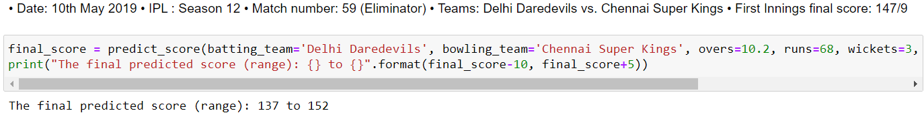
We trained our model on the data based on 2008-2016.And then we test our model on the data of 2017 year.
And at last we use our model to predict on the data 2018 & 2019.

Slide 24
CONCLUSIONS
1. Total 13 teams has participated in the history of IPL, out of which few teams like Pune Warriors, Kochi Tuskers Kerela, Rising Pune Supergiants, Gujarat Lions has been played 2 seasons and that’s why their success rate is good when compared to others.
2. Mumbai Indians & Chennai Super Kings are best defending teams whereas Royal Challeger Banglore & Kolkata Knight Riders are best chasing teams.
3. Overall, Chennai & Mumbai are the teams who won most number of IPL titles, with 4 & 3 respectively.
4. Chris Gayle has won most number of man of matches title with total 21.
5. Cities like Kolkata & Banglore are most likely to have bad weather and that’s why its not good to organize a knockout matches in those cities.
6. Teams have won more matches in their home ground.
7. Stadiums like M Chinnaswamy stadium & Eden Gardens is best suited for fielding whereas MA Chindambaram is best suited for batting.

Slide 25
REFERENCE
https://www.kaggle.com/nowke9/ipldata?select=matches.csv
https://www.kaggle.com/rushikeshlavate/ipl-dataset
https://www.barcindia.co.in/newsletter/ipl-over-the-years.pdf

Slide 26
THANK YOU…!

